Slide 1
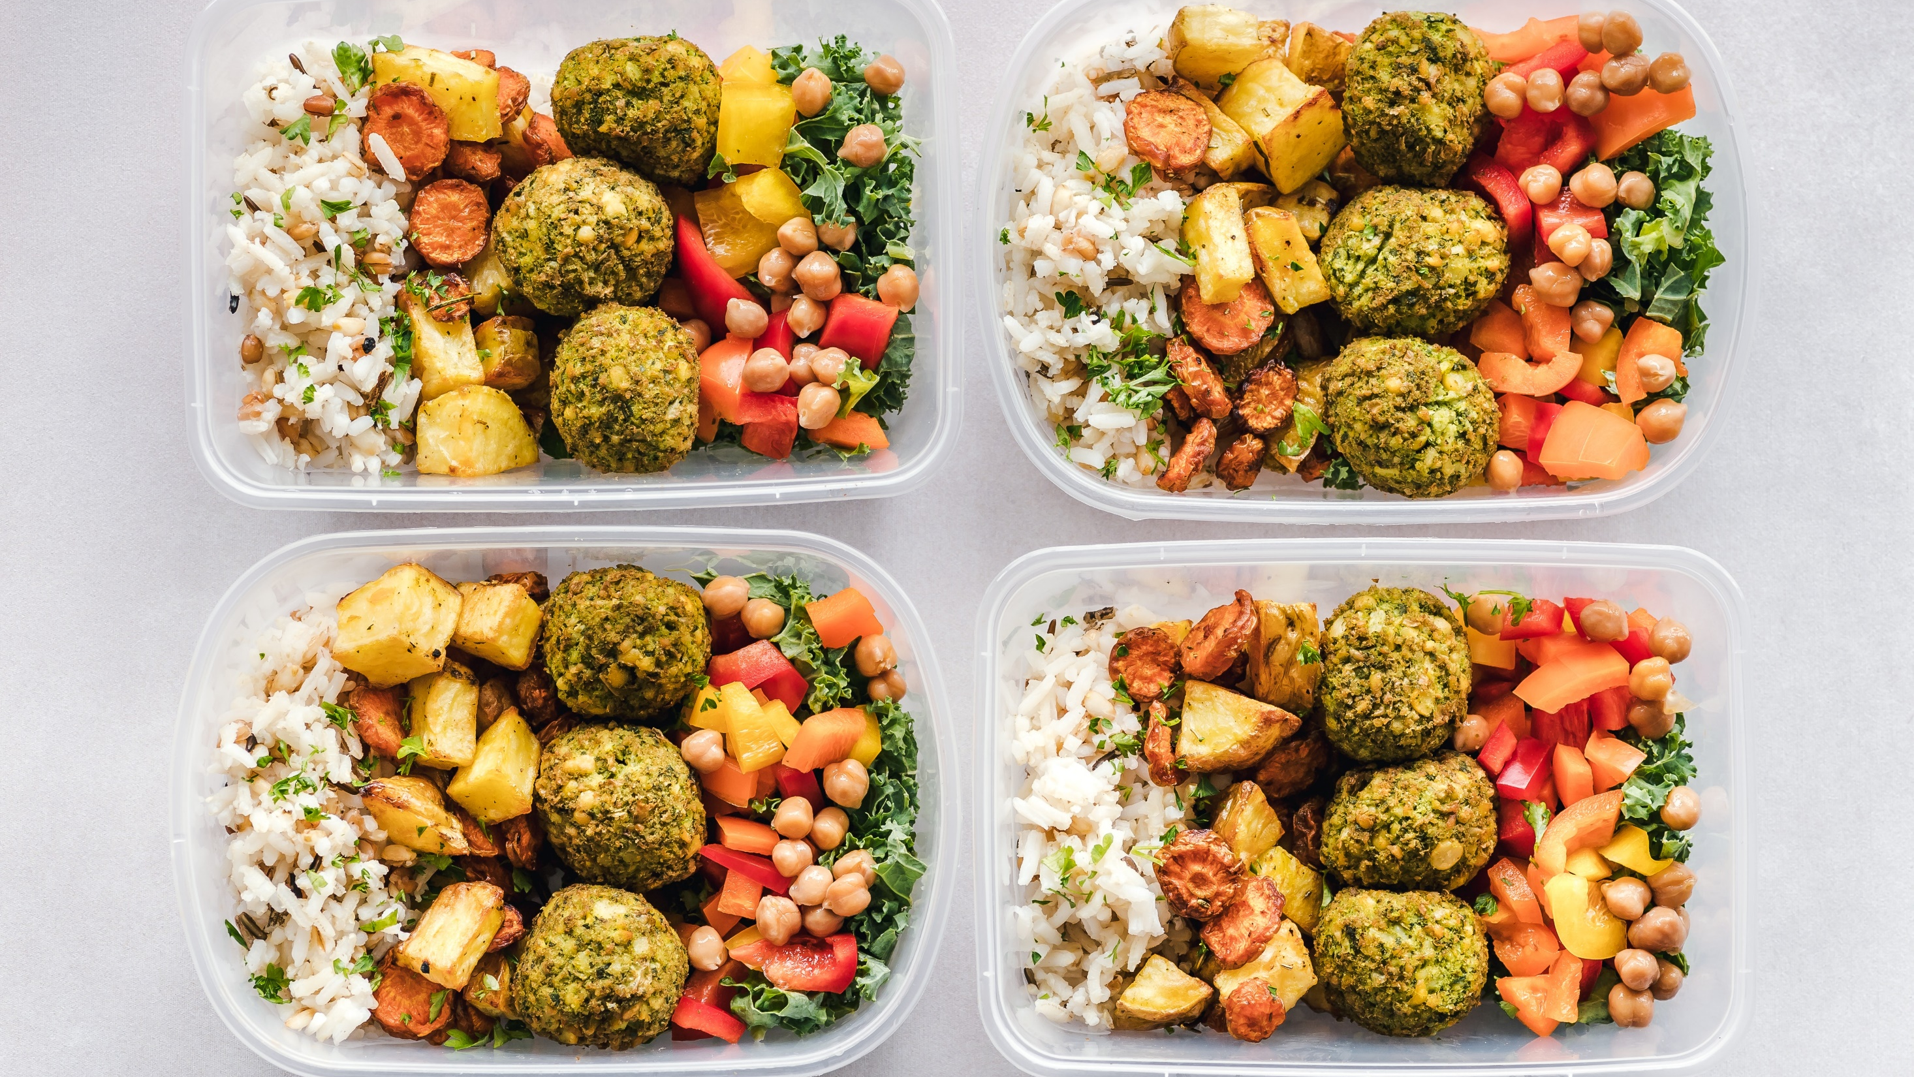
WEEK
9
MEAL AND SNACK MAP

Slide 2
Icebreaker
What was your favourite recipe that we made together?

Slide 3
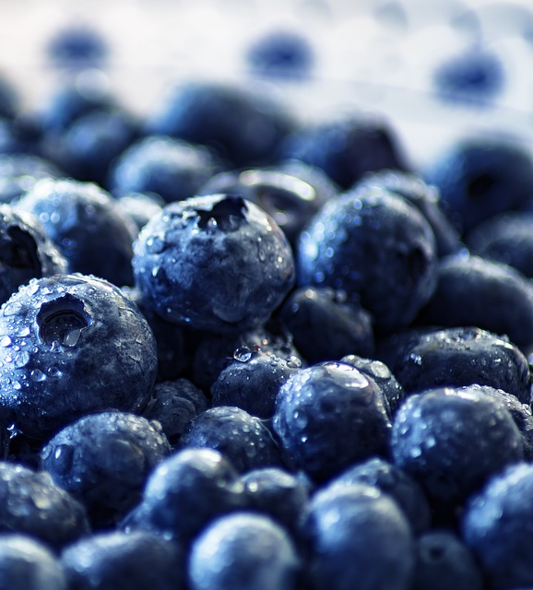
ON THE MENU
MEAL TIME CHALLENGES
Time
Food Cost
Healthy Recipe Ideas & Confidence
LETS GET ORGANIZED
Map it Out
SNACK ATTACK
FINAL TIPS
KNOWLEDGE CHECK
ACTIVITY

Slide 4
Meal Time Challenges
1. TIME
2. FOOD COST
3. HEALTHY RECIPE IDEAS & CONFIDENCE

Slide 5
Time
1
It can be hard to motivate ourselves to cook and prepare food if we don’t know what to make or don’t have any ingredients!

Slide 6
TIME: PLAN AHEAD!
Map out your week in advance and go shopping once. Make extra food for leftovers.
If you have basic ingredients on hand, you can prepare simple meals QUICKLY!
Example: Spaghetti and meatballs in 15 minutes
Dry pasta (pantry)
Canned pasta sauce (pantry)
Prepared meatballs (freezer)
Frozen spinach or vegetables (freezer)

Slide 7
2
COST
IS EATING OUT CHEAPER THAN COOKING ?

Slide 8
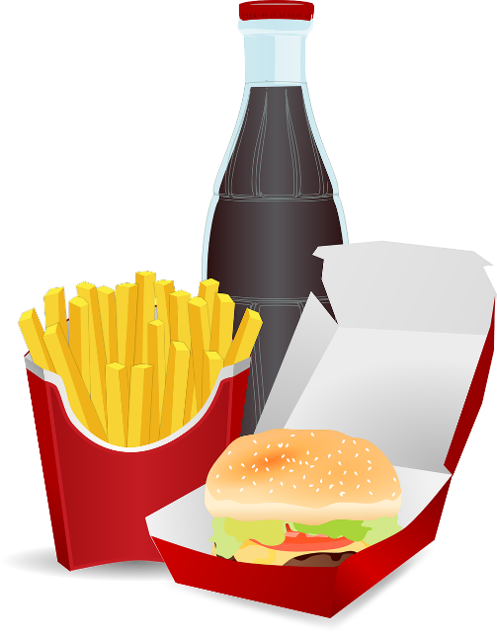
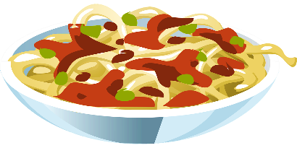
FAST FOOD RESTAURANT
AT HOME
¼ lb Burger with Cheese, Medium Fries, Medium Soft Drink
1 cup Pasta with Chicken Meatballs, Salad, and Milk
~$9.00 per person
~$4.00 per person
43g fat
13g fat
1340mg salt
653mg salt
65g sugar
22g sugar
1080 kcal
615 kcal
Which of these follows our Balanced Plate?

Slide 9
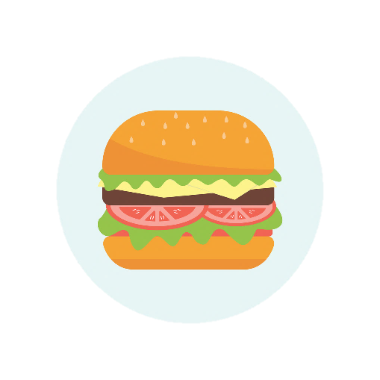
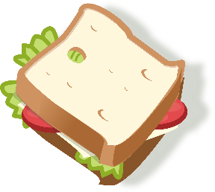
COST
Buying Lunch (Fast Food or Cafeteria)
3 days per week – ~$10/day
Buying Coffee, Tea, Energy Drinks, Soda
5 days per week ~$2.25/day
$120.00
per month
$45.00
per month
Eating at a Sit Down Restaurant
1 day per week – $25/day
SAVE MONEY! COOK AT HOME!
$100.00
per month

Slide 10
IDEAS AND CONFIDENCE
3

Slide 11
HEALTHY RECIPE IDEAS
Where do you find healthy recipes?
Cookbooks
Internet
Friends or Family
Experiment
Adapt a recipe
Remember last week?
Practice!
Keep trying new things, watch videos, and experiment

Slide 12
LET'S GET ORGANIZED

Slide 13
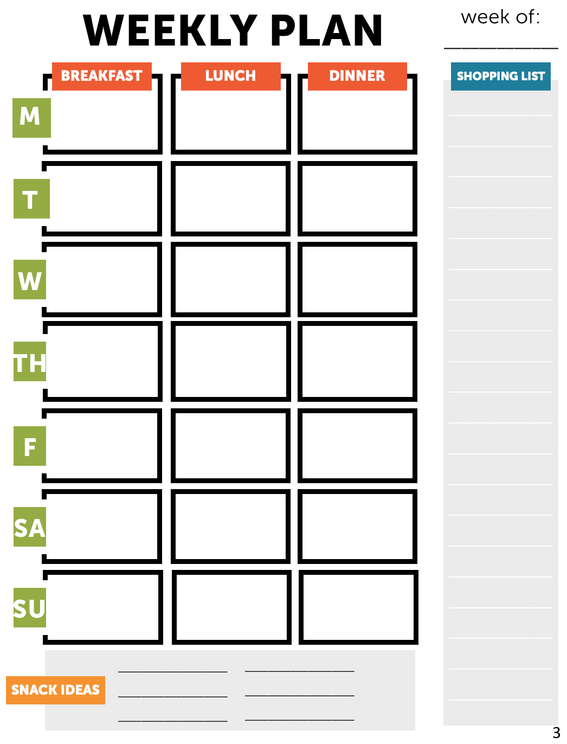
MAP IT OUT
The best way to overcome mealtime challenges- is planning
Take the time to plan what snacks and foods you would like to have each week
Remember: Cook once, eat twice!

Slide 14
MAP IT OUT
Get Shopping: Make a list.
Check flyers to help save more money!
Pick a day and plan: Choose a day to meal prep (Sunday!). Plan a menu.
Cook once, eat twice: Cook meals or prepare snacks for the week.
Make extra for leftovers!
Check the fridge: See what you already have!
Find recipe or snack ideas Adapt to make them healthier and build a balanced plate.

Slide 15
SNACK
ATTACK

Slide 16
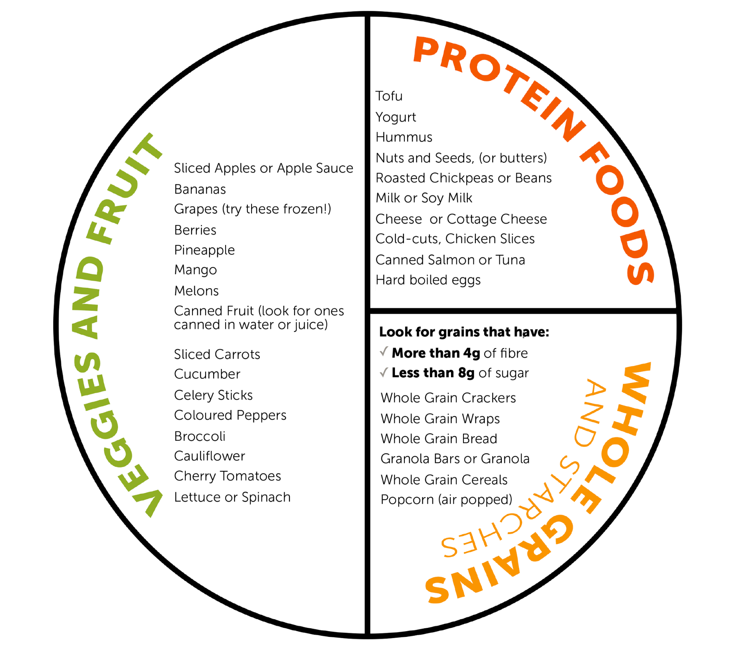
SNACK ATTACK
Mix and match items from at least 2 categories!

Slide 17
FINAL TIPS
1
Make Small Changes:
Add more vegetables to the meals you already cook
Remember fresh, frozen, and canned are all great
2
Try Something New:
Use the internet to search for recipes using ingredients you already have in the fridge
Spinach, chicken, cheese
3
Be Prepared
Get others involved to help (fri
Remember to always cook enough for leftovers
4
Keep At It!
Keep practicing and experimenting
Remember to always cook enough for leftovers

Slide 18
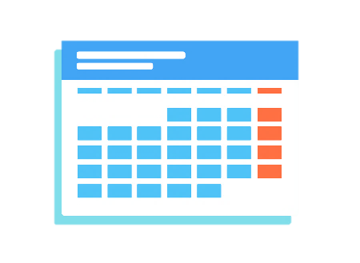
KNOWLEDGE CHECK
1
2
3
PLAN AHEAD
GET OTHERS INVOLVED
KEEP AT IT
Spinach, chicken, cheese

Slide 19
ACTIVITY TIME!
FILL OUT YOUR HANDOUT!

Slide 20
Thank you to our sponsor
Canada’s Children’s Hospital Foundations (CCHF) is grateful for Sun Life Financial’s $2 million commitment to support the creation of Meant2Prevent: A type 2 diabetes prevention initiative for children and youth presented by Sun Life. As part of Sun Life Financials’ Team Up Against Diabetes platform, this partnership allows the children’s hospital network of experts to positively influence children and youth to live healthier lives through awareness and education. Thank you Sun Life Financial for your dedication to building sustainable, healthier communities and families by helping to prevent type 2 diabetes.

Slide 21
This project is part of
www.Meant2Prevent.ca
www.Meant2PreventKitchen.ca

